Slide 1
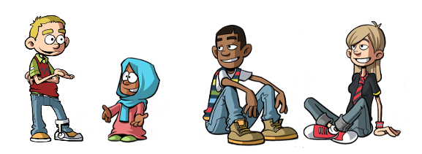
OUR CHARTER – ARTICLE 28 THE RIGHT TO AN EDUCATION

Slide 4
The Importance of Education for all
https://www.youtube.com/watch?v=Un5msddQl6U

Slide 5
WHAT YOU CAN DO…………
ARRIVE AT CLASS ON TIME
FOLLOW INSTRUCTIONS
SUPPORT YOUR CLASS MATES
COMPLETE CLASS WORK
DO HOMEWORK ON TIME
ASK QUESTIONS
ATTEND SUPPORTED STUDY WHEN IT STARTS
APPLY YOUR BEST EFFORT AT ALL TIMES!

